Slide 1
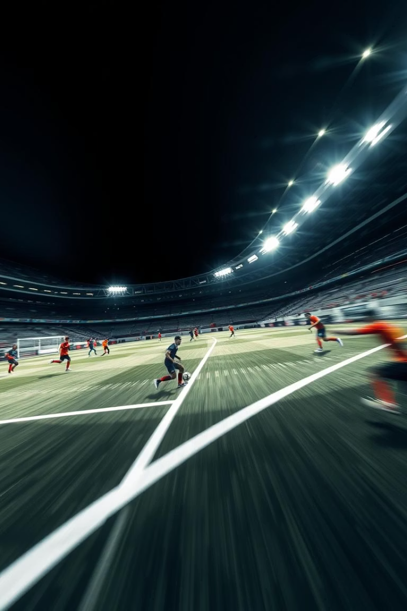
FOOTBALL ANALYZER
Real-time Performance Insights for Every Player on the Field.
Team Members -
Anirudh Chauhan (E23CSEU1532)
Aditya Sharma (E23CSEU1533)
Maruti Srujan (E23CSEU1544)

Slide 2
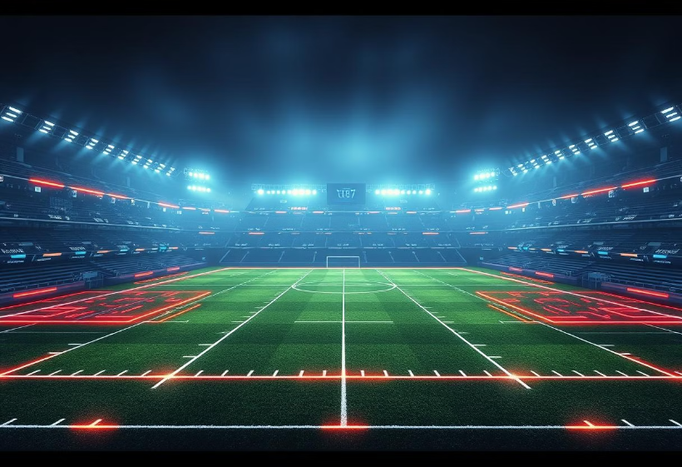
The Need for Real-Time Data
Traditional football match analysis is slow and imprecise.
It provide real-time data for crucial in-game decisions.
The rise of AI has potential, but faces limitations in providing on-the-field performance tracking.
Analysts need insights into player speed and reaction time in real-time.

Slide 3
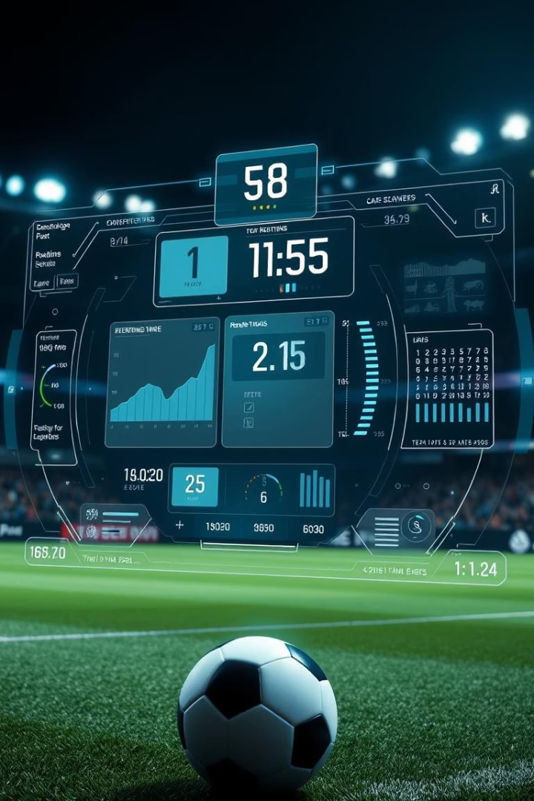


Introducing FOOTBALL ANALYZER
Real-time Tracking
Speed Calculation
Analyzes matches using computer vision and ML to track players.
Calculates speed, tracking both average and peak speeds during a match.
Ball control teamwise
It will calculate the ball control accurately in real time that which team has more control of ball

Slide 4
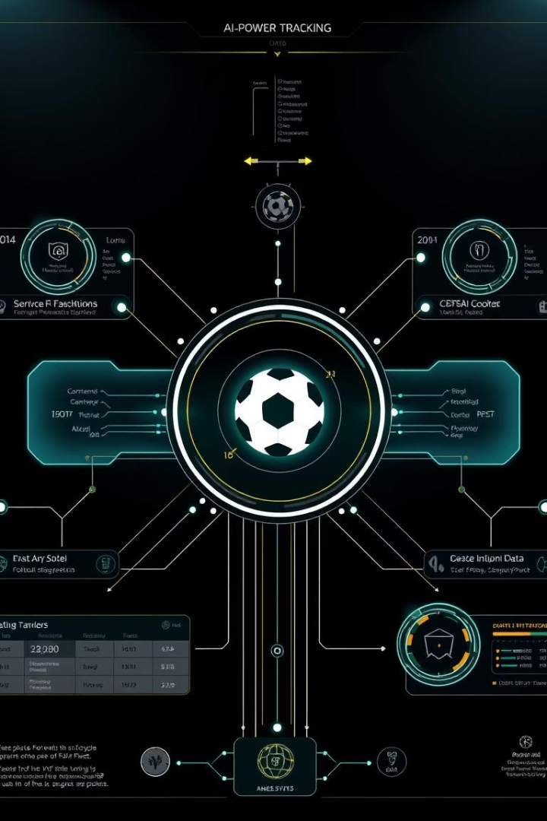




Core System Functionalities
Player Tracking
Uses AI-powered object detection to track each player, even in crowded scenes.
Speed Analysis
Calculates displacement between frames with timestamps.
Data Visualization
Displays metrics like speed over time and player comparisons.
Tracking Ball Speed
Uses AI-powered object detection to track ball, and calculate it speed.

Slide 5





Behind the Scenes
Input Layer
Receives video footage and breaks it down into frames.
Preprocessing
Extracts key frames, detects players, and focuses on areas of interest.
Model Core
Identifies players, calculates speed of players and the ball
Output
Produces data report or visual dashboard displaying metrics.

Slide 6
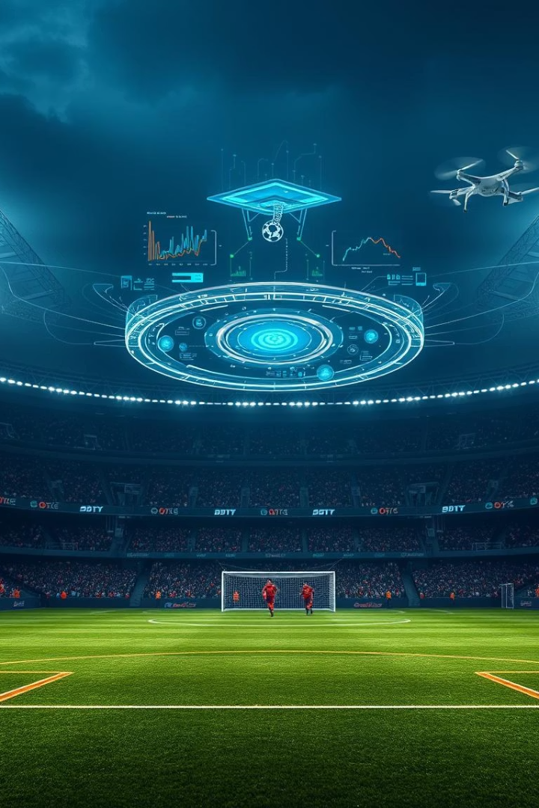
AI/ML Powering the System
Object Detection: YOLO
Pose Estimation
Tracking body positions for movement and reaction times.
Detecting and tracking players in real-time.
Speed Estimation
Algorithms compare displacement between frames.

Slide 7




Dataset and Training
Dataset
Annotation Tools
Trained on match footage with labeled annotations.
Tools used to label data for speed or reaction time.
1
2
Model Evaluation
4
3
Training Process
Accuracy, precision, recall, and F1 score metrics.
Techniques for balancing accuracy with computational efficiency.

Slide 8
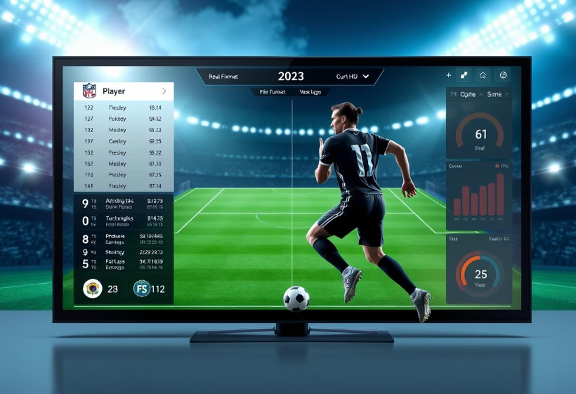
Demonstration of Real-Time Analysis
A short video clip demonstrating real-time analysis.
Overlaid player tracks show their speed and reaction times.
Sample output dashboard with visual graphs showing player performance.

Slide 9
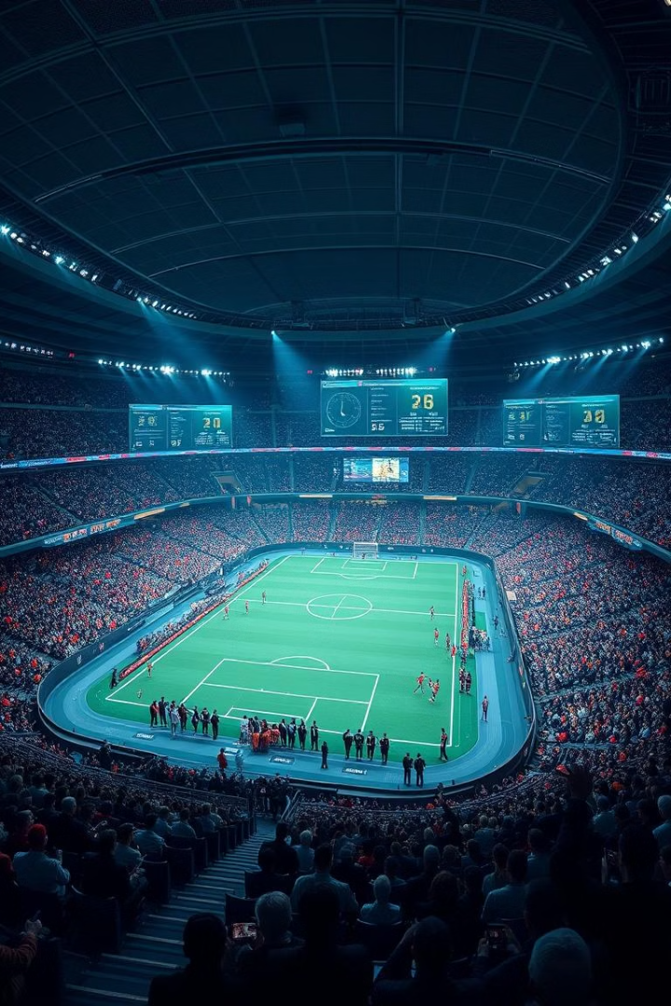




Real-World Applications
Professional Teams
Broadcasting
Scouting
Detailed player analytics during live broadcasts.
Track performance over time to assess attributes.
In-game analysis, making data-driven decisions.
Video Games
Realistic AI behavior and player movement.

Slide 10

Challenges and the Road Ahead
Variable lighting can affect video quality.
Players may be obscured by others.
Smooth, real-time performance is costly.
Future improvements include better detection and additional features like fatigue tracking.

Slide 11
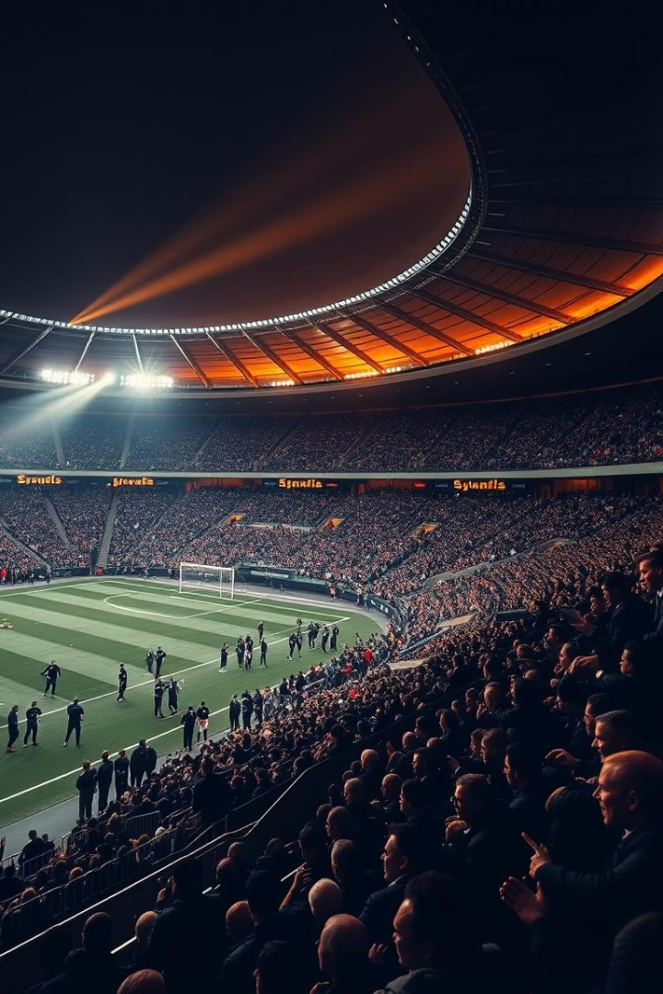
Thank You
Thank you for your time and consideration.

